Slide 1
Flash Drivers
Austin Apt, Anubhav Nigam, Mingkun Tao

Slide 2

Real Estate Database: The Future of Finding a Home

Slide 3
Search Criteria
With the proliferation of highly specialized search sites such as Cargurus or Reverb.com, our group was surprised to find real estate and property apps like Zillow did not allow for more complex data queries including relevant information about the locale.
20XX | 20XX | 20XX | 20XX

Slide 4
What Matters?
To know the numbers of rooms, square footage, renovations, year built, etc of a house is certainly important, but it does not provide any information about the town or locale beyond its walls.
It’s possible to take a zip code and find out more about that city on wikipedia or elsewhere but our program will consolidate these disjoint information sources.

Slide 5

The solution
What factors are most relevant when trying to buy a home?
Ex: School district, local economy, crime statistics

Slide 6
The Data: California
Zillow California Housing Data Set
1,006,371 TUPLES
California Counties
57 TUPLES
California School by District
770 TUPLES
California Income+Area Stats by Zip
1101 TUPLES

Slide 7
The Data: Pre-Processing
Zillow California Housing Data Set
Removed tuples which contained 0 bedrooms and/or bathrooms
California Counties
Created new attribute for better interpretability
California School by District
Removed extraneous columns
California Income+Area Stats by Zip
Cells with no value set to zero

Slide 8
App Functionality
List properties with typical inclusive properties similarly to Zillow currently
Create additional search fields which allow the user to query for a more relevant and smaller set of properties

Slide 9
Example Queries
“Show me all properties in California located in a school district with an average test score greater than 800 [out of 1000] and less than 5 crimes per employed law officer for the county of that property.”
“Show me all properties in California with two car garages, priced less than $1,000,000 and located in zip codes with median incomes greater than $80,000.

Slide 10
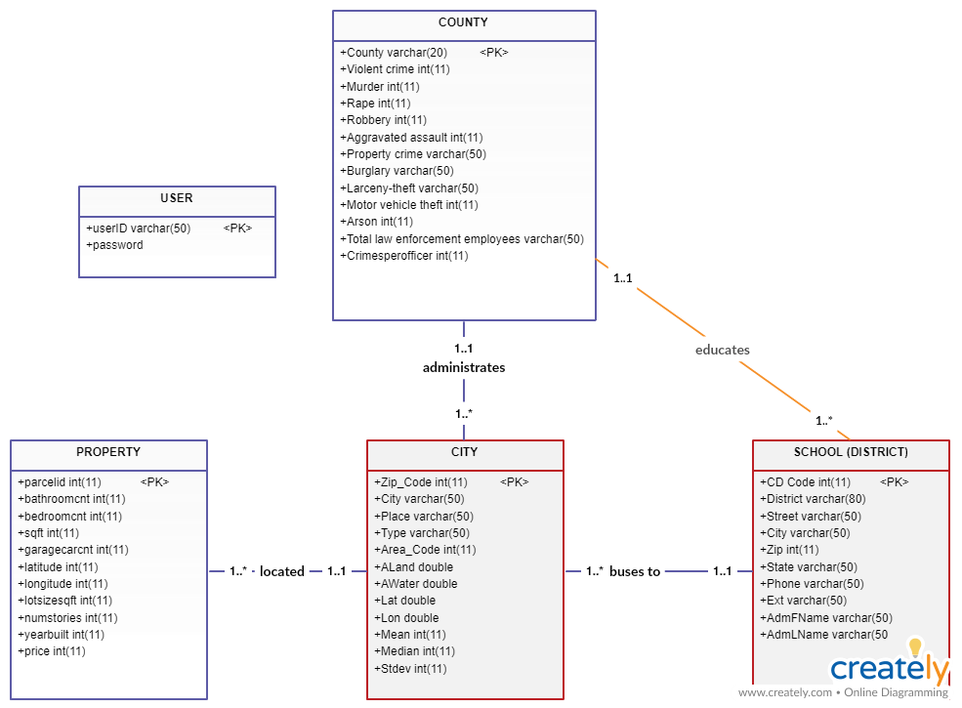
UML Diagram
avg_API int(11)

Slide 11
RELATIONAL MODEL from UML
CITY (Zip_Code, City, Place, Type, Area_Code, ALand, AWater, Lat, Long, Mean, Median, Stdev, countyName, schoolCode)
PROPERTY (parcelid, bathroomcnt, bedroomcnt, sqft, garagecarcnt, latitude, longitude, lotsizesqft, regionidzip, numstories, yearbuilt, price, cityZip)
COUNTY (County, Violent crime, Murder, Rape, Robbery, Aggravated assault, Property crime, Burglary, Larceny-theft, Motor vehicle theft, Arson, Total law, Crimesperofficer)
SCHOOL (CD Code, District, Street, City, Zip, Phone, Ext, AdmFName, AdmLName, AdmEmail, avg_API, cName)
4 FOREIGN KEYS

Slide 12
Relations+Functional Dependencies from Primary Keys
Relations
Located in: parcelId-->CITY.Zip_Code
Educates: CDCode-->County
Buses to: CITY.Zip_Code-->CDCode
Administrates: CITY.Zip_Code-->County
Closure on parcelId:
parcelId->CITY.Zip_Code
CITY.Zip_Code->CDCode, County
All four primary keys have been derived from the closure of the first functional dependency, thus an all-keys table is NOT required.

Slide 13
BCNF Decomposition Steps

Slide 14
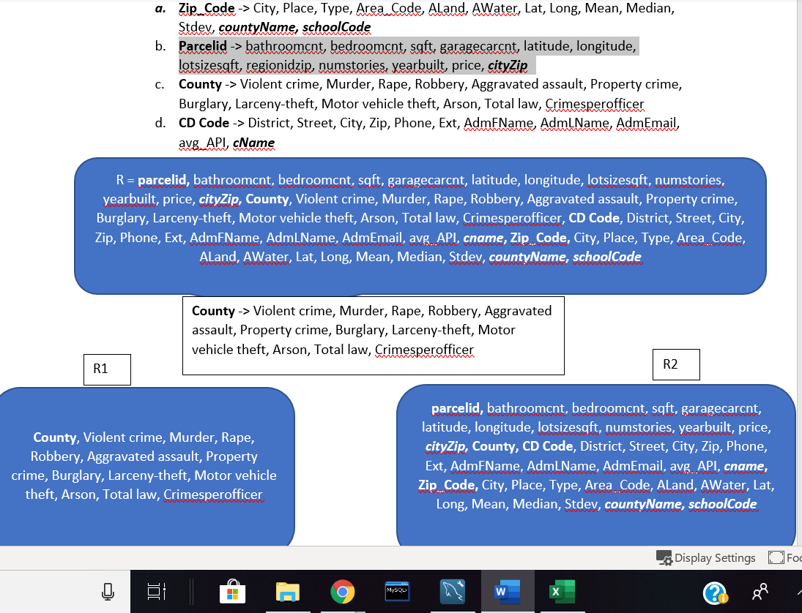
FD’s and First Split

Slide 15
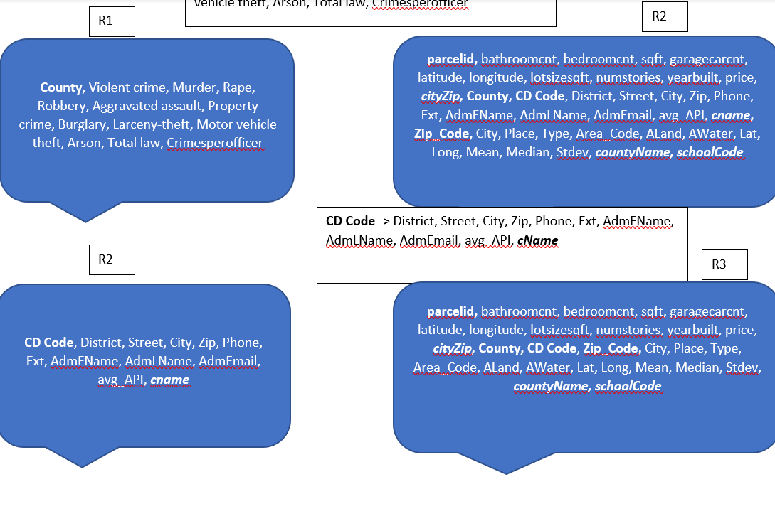
Second Split

Slide 16
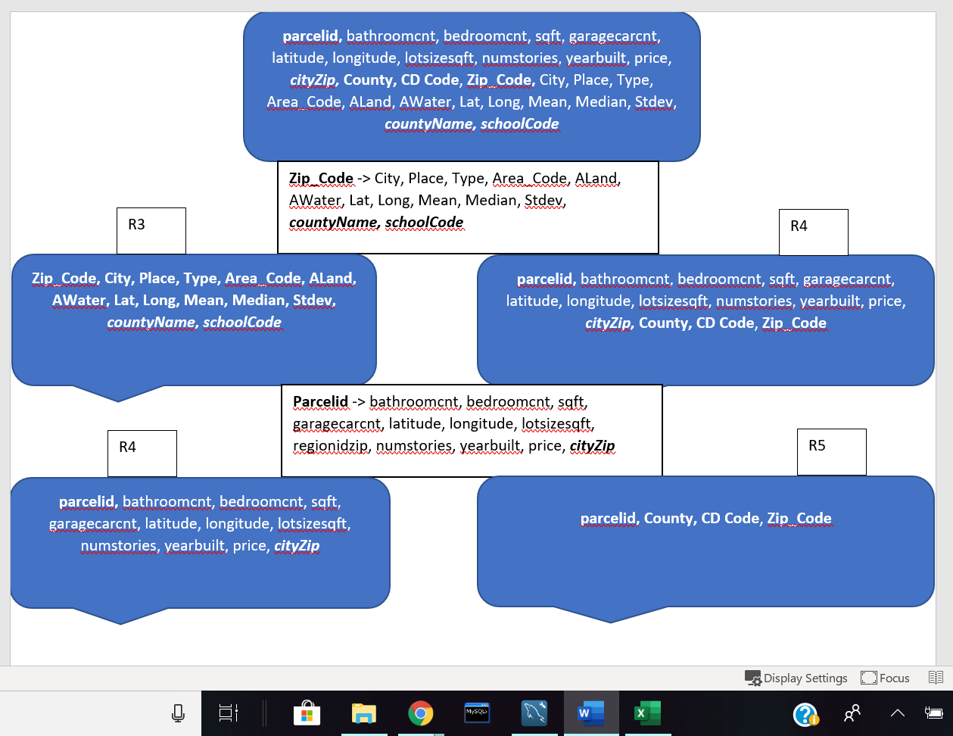
R3, R4
Notes:
Split last table based on Zip--->County, CD Code

Slide 17
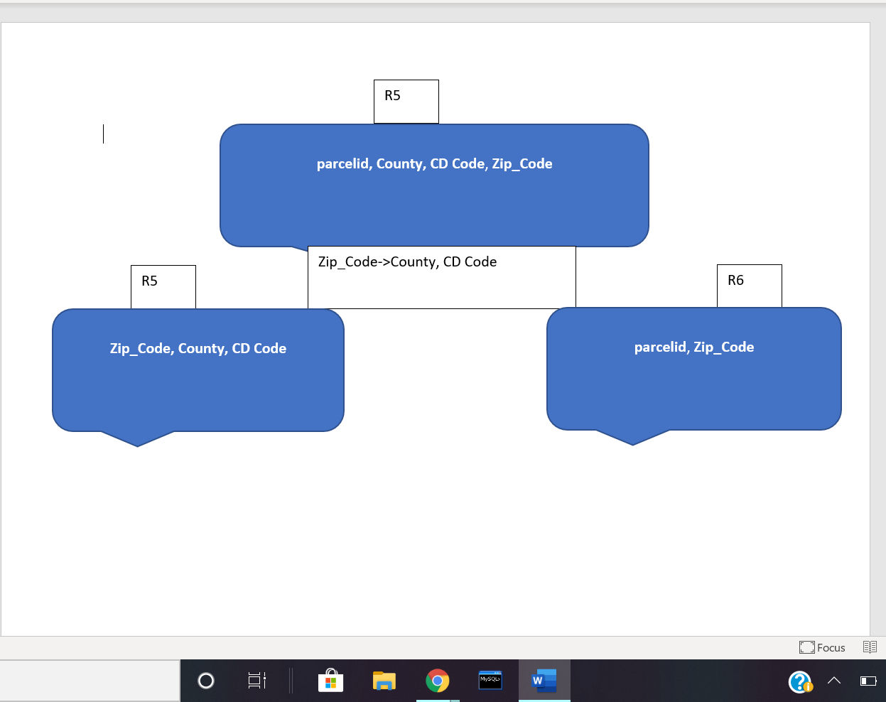
Last Split
Notes:
Split last table based on Zip--->County, CD Code

Slide 18
DEMO

Slide 19
CHALLENGES AND FUTURE DEVELOPMENT
Challenges
The creation of separate tables in MySQL was simple, but setting foreign keys and forming connections between the data tables was difficult.
Integration of front-end with back-end.
Future Development
Integration of data+tables with geospatial data. A more advanced version of this app would be able to search for relations based on the distance between entities calculated via their latitude+longitude. If entities are missing this data, it is possible that zip code could be converted into the latitude and longitude of the center of the given zip area.
More information with regards to county, city, etc.

Slide 20
QUESTIONS

